Slide 1


Amazon Cellphone Sentiment Anlaysis USING IBM CLOUD:
Team Members:
REKHA EJJAGIRI
ROHITH SHERIPALLY
SUDHAGANI AJAY KUMAR
SUDHAMALLA VISHWA TEJA
YANAMALA JAGADESHWARI

Slide 2

INTRODUCTION:
Mobile phones have revolutionized the way we purchase products online, making all the information available at our fingertips. Reviews and ratings submitted by consumers became an integral part of the customer’s buying decision process. The review and rating platform provided by e-Commerce players creates a transparent system for consumers to take decisions and feel confident about it.
However, it is difficult to read all the feedback for a particular item especially for the popular items with many comments. In this project, we will attempt to understand the factors that contribute to classifying reviews as positive or negative.
We will be using Natural language processing to analyze the sentiment (positive or a negative) of the given review. A sample web application is integrated to the model built.

Slide 3
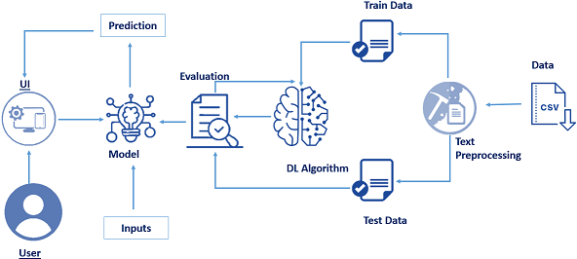
Technical Architecture:

Slide 4
Problem Statement:
Amazon Cellphone Sentiment Anlaysis

Slide 5
Problem Solution:
Building the model which can analise the reviews of cellphone on Amazonthe model can annalise the sentiment of the reviews which are positive andwhich are negative.

Slide 6
Data Collection:
The dataset used for this project was obtained from Kaggle. The data collected from Amazon it is about unlocked mobile phones. It consists of 67986 reviews and it contains 8 columns (67986 rows × 8 columns).
ML depends heavily on data, without data it is impossible for an “AI” to learn. It is the most crucial aspect that makes algorithm training possible. In Machine Learning projects, we need a training data set.

Slide 7
Text Preprocessing:
Import Required Libraries:
We will be using different libraries for the steps that are included in this step. “Re” is the library that is used to replace the selected special characters with the desired parameter. “NLTK” – Natural language Tool Kit is the library used for stemming using a special class in the library.
let's add the below libraries to the script file.

Slide 8
Text Pre-processing includes the following main tasks
-Import the Libraries.
-importing the dataset
-Remove Punctuations
-Convert each word into a lower case.
-Stemming
.-Splitting Data into Train and Test

Slide 9
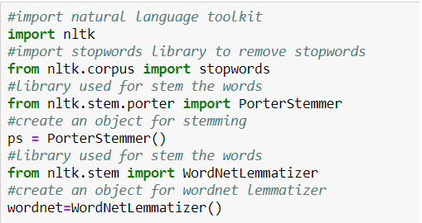

Slide 10
Model Building:
Now that the data is cleaned and ready for model building, let's use the preprocessed data to train the model Model building includes
-Training The Model
- We make use of artificial Neural networks to train the model
-Saving the model
-Testing the model

Slide 11
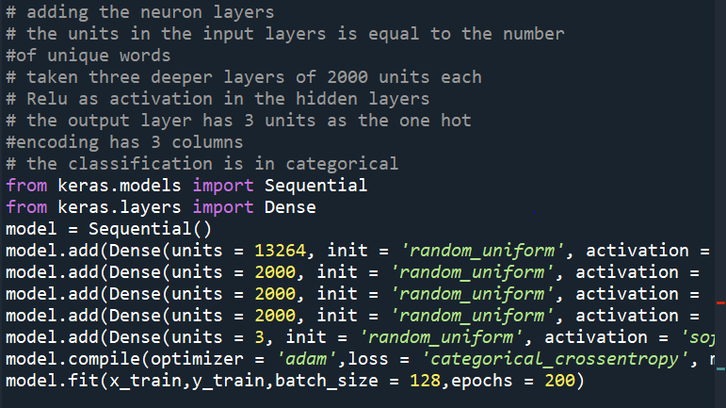
Train the Model:

Slide 12
Application Building:
>Application Building Flask Frame Work with Machine Learning Model. In this section, we will be building a web application that is integrated into the model we built. A UI is provided for the uses where he has to enter the values for predictions. The enter values are given to the saved model and prediction is showcased on the UI.

Slide 13
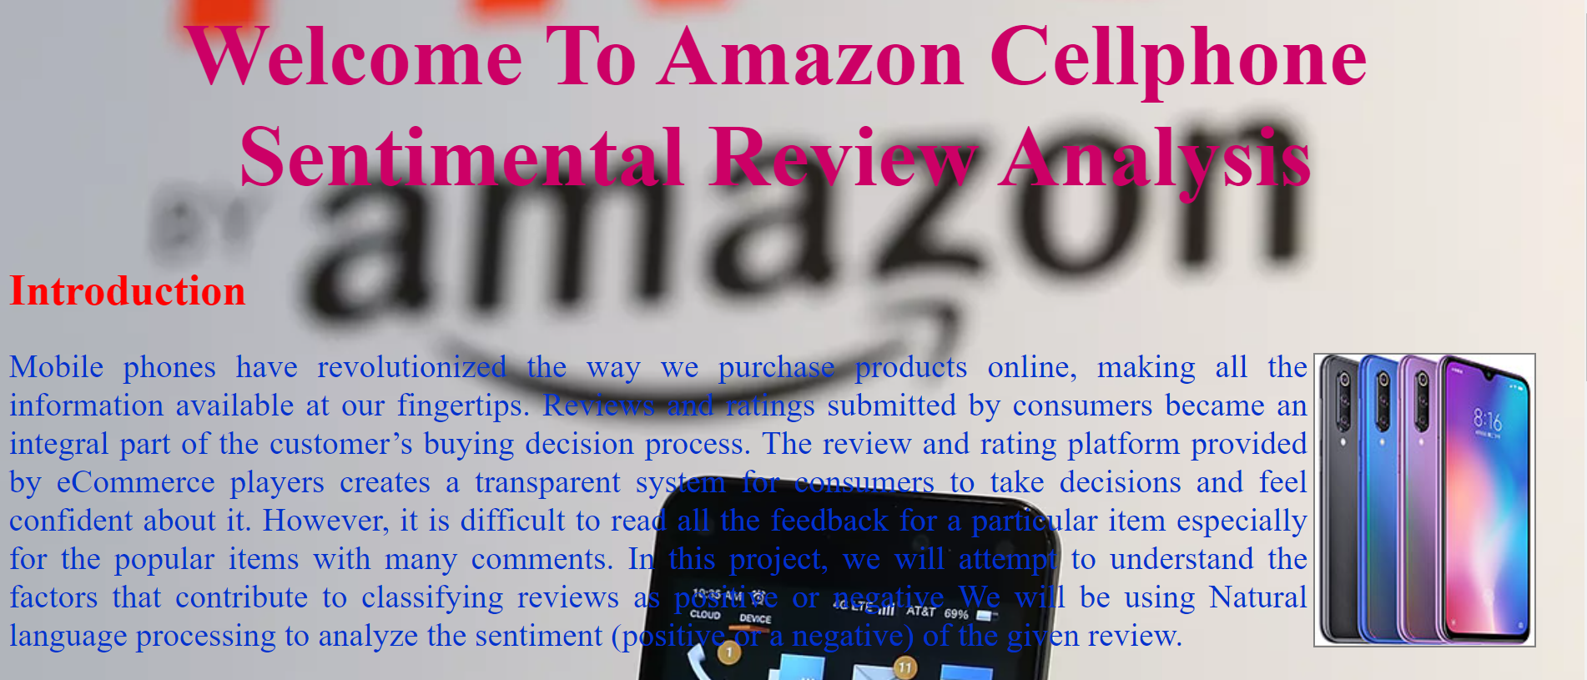
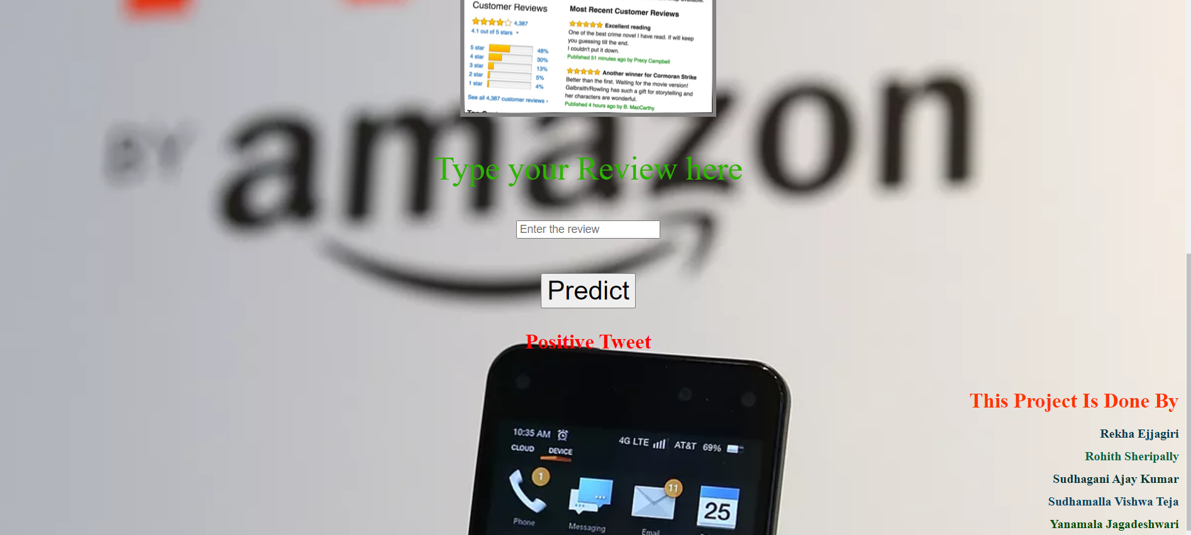

Slide 14
Thank you

